Slide 1
Class Relationships and Object Interaction
CS 21a: Introduction to Computing I First Semester, 2016-2017

Slide 2
Class Relationships
More complex programs require multiple classes
It is typical for objects to have fields that refer to other objects
In class A, there may be a field whose type is class B
There is a class relationship between A and B

Slide 3
Class Relationships
Types of class relationships
Composition or Aggregation
Association

Slide 4
Object Composition
Objects can be composed of other objects
Have references to "parts" of the class as fields of the class
Objects can create instances of other objects
Also called aggregation

Slide 5
Encapsulation
The idea of "hiding" implementation details
What's more important is the interface
Users don't need to know how a method works, just that it's there and it works
Objects know how to handle themselves
users don't need to know

Slide 6
Encapsulation
Data should be hidden with the object that it belongs to
Changes to data should be done via methods of object that contains the data
Again… objects should know how to handle the data
Allows the object's programmer to change data representation
This is why we make fields private

Slide 7
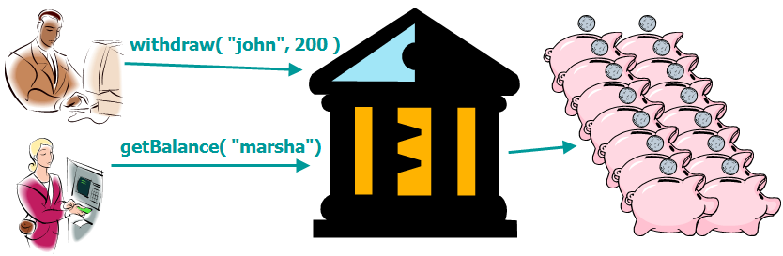
Bank Example
A Bank encapsulates a set of BankAccount objects
What's important is the external interface
Users don't need to know what goes on inside the Bank

Slide 8
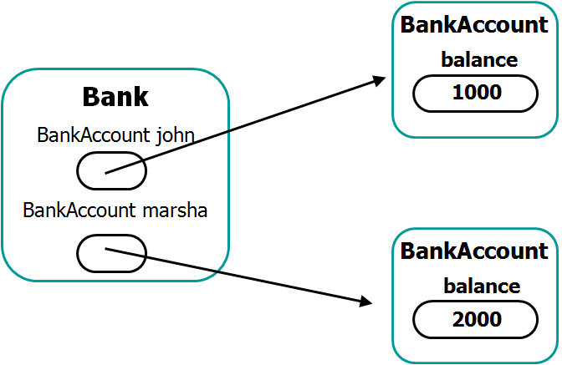
Bank and BankAccount

Slide 9
Object Composition in Java
There are BankAccount fields in Bank
public class Bank {
private BankAccount john;
private BankAccount marsha;
public Bank() {
john = new BankAccount(1000);
marsha = new BankAccount(2000);
}
public void deposit(String name, double amt) {
if( name.equals("john") )
john.deposit( amt );
...
} ...
}
The fields are instantiated in Bank's constructor
Bank has its own deposit method that calls BankAccount's deposit method on the appropriate object

Slide 10
Using a Bank Object
Bank b = new Bank();
b.deposit("john",200);
b.withdraw("marsha",100);
System.out.println(b.getBalance("john"));
System.out.println(b.getBalance("marsha"));
Prints:
1200
1900

Slide 11
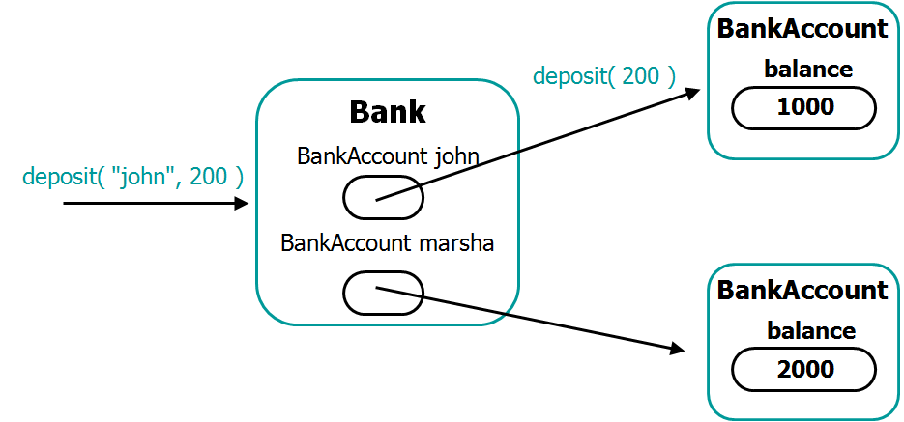
Object Interaction
Calling deposit on the Bank object causes deposit to be called on a BankAccount object

Slide 12
The whole manages its parts
In effect, Bank is a manager of BankAccounts
Transactions are carried out through the Bank object but ultimately uses/affects a BankAccount object
The one calling Bank's methods does not even need to konw about the BankACcount class -- this is exactly what encapuslation is about

Slide 13
Object Association
Association: a weaker kind of relationship
Unlike in the case of composition or aggregation, the creation or existence of one object does not depend on another
Examples
Borrower and Book in a library system
Student, Class, Teacher in a university system
WaterTank and Faucet

Slide 14
WaterTank-Faucet Example
A WaterTank object has methods that cause it to be filled up with water or to dispense water
A Faucet object is connected to a WaterTank and has methods to dispense or drain water
Faucet needs a way to connect/associate to a WaterTank object
Note: we can connect several faucets to a single water tank

Slide 15
WaterTank-Faucet Association
Option 1: create WaterTank object, create Faucet object(s), and call a method on Faucet WaterTank w = new WaterTank(); Faucet f1 = new Faucet(); Faucet f2 = new Faucet(); f1.connect(w); f2.connect(w);

Slide 16
WaterTank-Faucet Association
Option 2: Faucet's constructor has a WaterTank parameter WaterTank w = new WaterTank(); Faucet f1 = new Faucet(w); Faucet f2 = new Faucet(w);

Slide 17
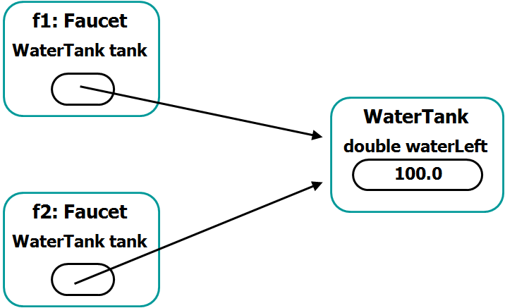
WaterTank and Faucet

Slide 18
Object Association in Java
The association is represented by a WaterTank field
public class Faucet
{
private WaterTank tank; public Faucet( WaterTank w ) {
tank = w;
}
...
public void connect( WaterTank w )
{
tank = w;
}
}
The field can be set in the constructor...
...or in a method

Slide 19
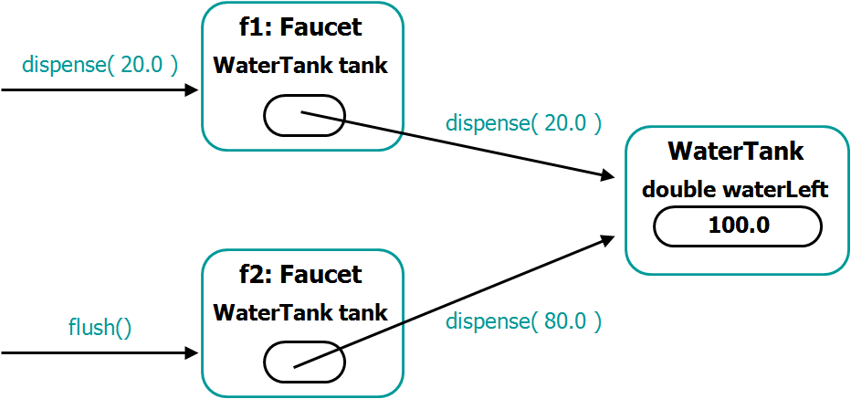
Object Interaction

Slide 20
Object Interaction
public class Faucet
{
private WaterTank tank;
public Faucet(WaterTank w)
{
tank = w;
} ...
public void dispense(double amt)
{
tank.dispense(amt);
}
public void flush()
{
tank.dispense( tank.getWaterLeft() );
}
}
public class WaterTank
{
private double waterLeft = 0;
...
public void fillTank()...
public void dispense(double amt )
{
waterLeft -= amt;
}
public double getWaterLeft()
{
return waterLeft;
}
}

Slide 21
Using Faucet and WaterTank Objects
WaterTank w = new WaterTank();
WaterTank x = new WaterTank();
w.fillTank(); // fill to capacity, like 100
x.fillTank(); // fill to capacity, like 100
Faucet f1 = new Faucet( w );
Faucet f2 = new Faucet( w );
f1.dispense( 20 );
f2.flush();
f1.connect( x );
f1.dispense( 50 );
System.out.println(w.getWaterLeft());
System.out.println(x.getWaterLeft());
Prints:
0
50

Slide 22
An Integrated Example
Grocery environment
Products are stocked and sold in the grocery
Cashiers are front-end objects that carry out a sale through a back-end price-and-stock Manager object
Multiple cashiers are associated to the Manager object
The Manager object aggregates Product objects (where prices and stock levels are stored)

Slide 23
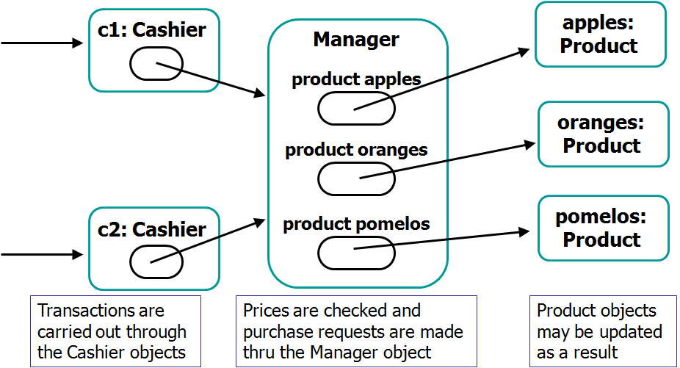
Grocery Example

Slide 24
Summary
In Java, a program is a collection of interacting objects
Programmers may develop multiple classes for these objects
The classes are related by
Composition / Aggregation
Association
Later in the semester, we will introduce another relationships: Inheritance

